Slide 1
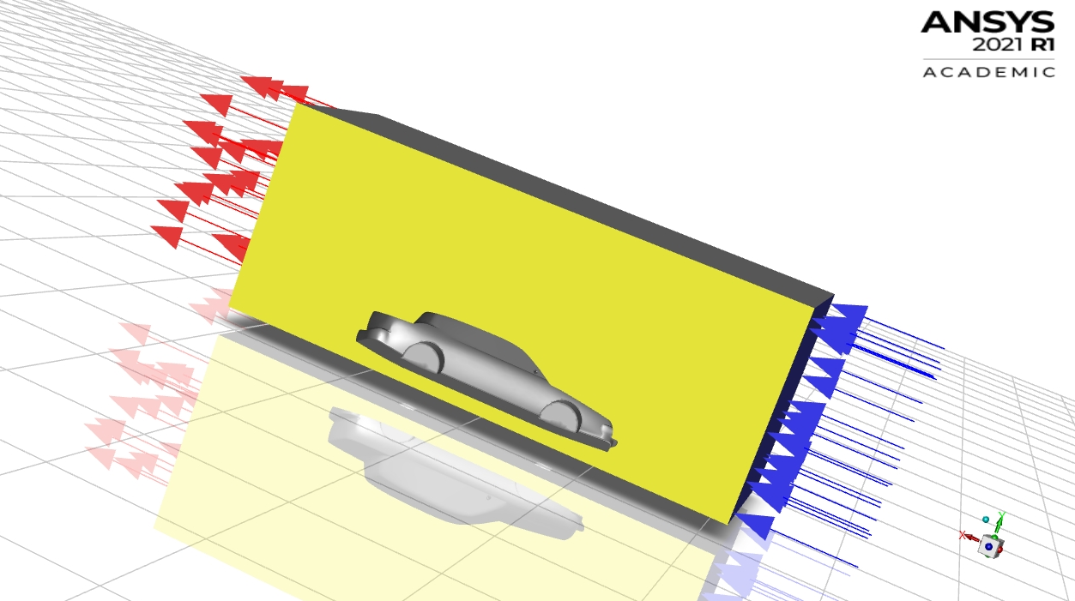
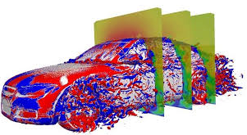
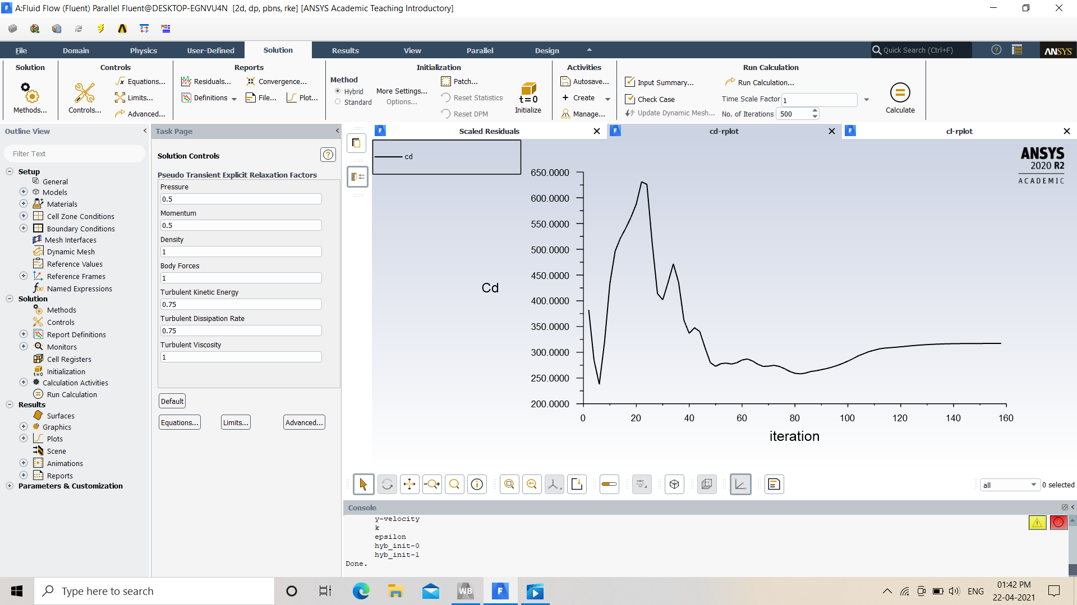
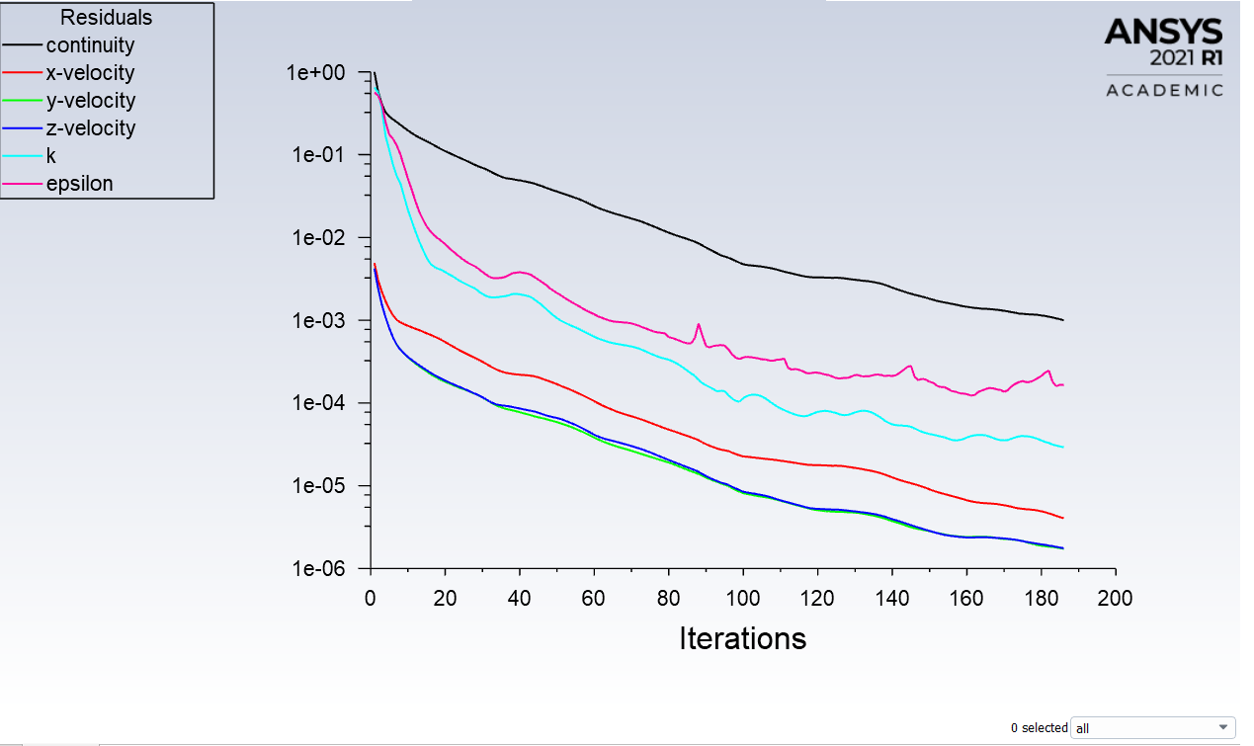
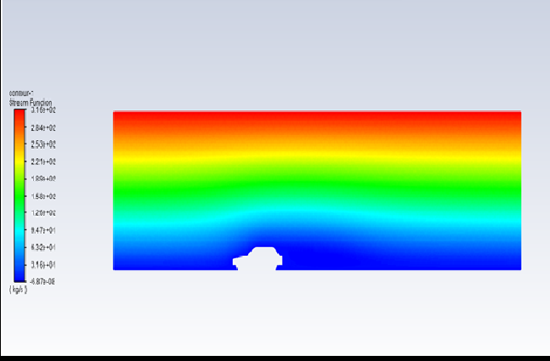
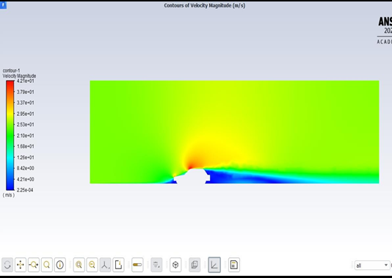
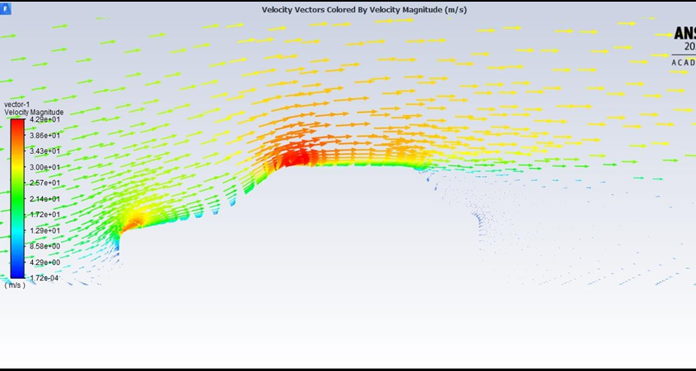
Fluid Mechanics
Project based Learning
Topic : FLOW OVER A CAR
Introduction
Results
Aerodynamic drag is the force opposite to the direction of motion that acts on a body moving through air. Drag force affects the performance and fuel efficiency of aircraft, road vehicles or racing cars as it works opposite to the direction of movement. About 50% to 60% of total fuel energy is lost to overcome the drag force, 30% to 40%to overcome road resistance and about 10% to 20% for operating electrical appliances. Thus reduction of aerodynamic drag has become one of the prime concerns in vehicle aerodynamics and great efforts in research have been employed for better fuel
economy and performance of aircraft and road
Vehicles due to market competition.
MESHING
Objective
Results
Increased Fuel consumption now-a-days is a great concern for customers as well as for carmakers. To overcome this problem carmakers often try to improve the aerodynamics of the car so that fuel consumption can be minimized. Aerodynamics can be improved by making design changes to the car or adding some aerodynamics components like spoilers, roof rails or vortex generator to the car. Components like vortex generators and spoilers offers great drag resistance and reduce the lift of the car. They also increases the mileage of a car.
Graph of Drag
Physics set up
Results
Steps involved in Physics Setup:
1. Use steady state pressure based solver and select all the options.
2.Set viscous model. Use realizable k-epsilon model.
3.Set material properties. Use constant density.
4.Define boundary conditions. Set inlet as Velocity- Inlet with Velocity Magnitude of 15 m/s.
Set outlet as Pressure-Outlet and symmetry as Symmetry.
Contours of stream function Contours of velocity magnitude
Numerical solution
Results
1.Set solution methods and controls. Use defaults.
2.Define monitors for drag and lift coefficients.
3.Initialize and fill number of iterations 1000 and run the simulation .
Results
Velocity vectors
Team Members :
Pankaj Thakur
Md Kamran
3.Rohit Chaudhary
Instructor : MR. Faisal

